Slide 1

HOUSING: PRICE PREDICTION
Mahaboob Basha Shaik

Slide 2
Problem Statement
Houses are one of the necessary needs of each person around the globe and therefore housing and real estate market is one of the markets which is one of the major contributors in the world’s economy. It is a very large market and there are various companies working in the domain. Data science comes as a very important tool to solve problems in the domain to help the companies increase their overall revenue, profits, improving their marketing strategies and focusing on changing trends in house sales and purchases. Predictive modelling, Market mix modelling, recommendation systems are some of the machine learning techniques used for achieving the business goals for housing companies. Our problem is related to one such housing company.
A US-based housing company named Surprise Housing has decided to enter the Australian market. The company uses data analytics to purchase houses at a price below their actual values and flip them at a higher price.
The company is looking at prospective properties to buy houses to enter the market. You are required to build a model using Machine Learning to predict the actual value of the prospective properties and decide whether to invest in them or not.

Slide 3
Understanding
House price forecasting is an important topic of real estate. The literature attempts to derive useful knowledge from historical data of property markets. Machine learning techniques are applied to analyse historical property transactions in India to discover useful models for house buyers and sellers. Revealed is the high discrepancy between house prices in the most expensive and most affordable suburbs in the city of Australia. Moreover, experiments demonstrate that the Multiple Linear Regression that is based on mean squared error measurement is a competitive approach.

Slide 4
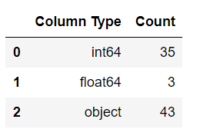
EDA
Mathematical/ Analytical Modeling of the Problem
Pandas: The Python Data Analysis Library is used for storing the data in data frames and manipulation.
NumPy: Python scientific computing library.
Matplotlib: Python plotting library.
Seaborn: Statistical data visualization based on matplotlib.
Scikit-learn: Sklearn is a machine learning library for Python.
SciPy. Stats: Provides a number of probability distributions and statistical functions.

Slide 5
EDA
Data exploration is the first step in data analysis and typically involves summarizing the main characteristics of a data set, including its size, accuracy, initial patterns in the data and other attributes. It is commonly conducted by data analysts using visual analytics tools, but it can also be done in more advanced statistical software, Python. Before it can conduct analysis on data collected by multiple data sources and stored in data warehouses, an organization must know how many cases are in a data set, what variables are included, how many missing values there are and what general hypotheses the data is likely to support.
The cleaning module removes the noise, and check that all the values are not empty, otherwise the item is dropped. This is done for simplicity; indeed, it could be better to try to inference them later. After the cleaning part done, the item is sent to the formatting module.

Slide 6
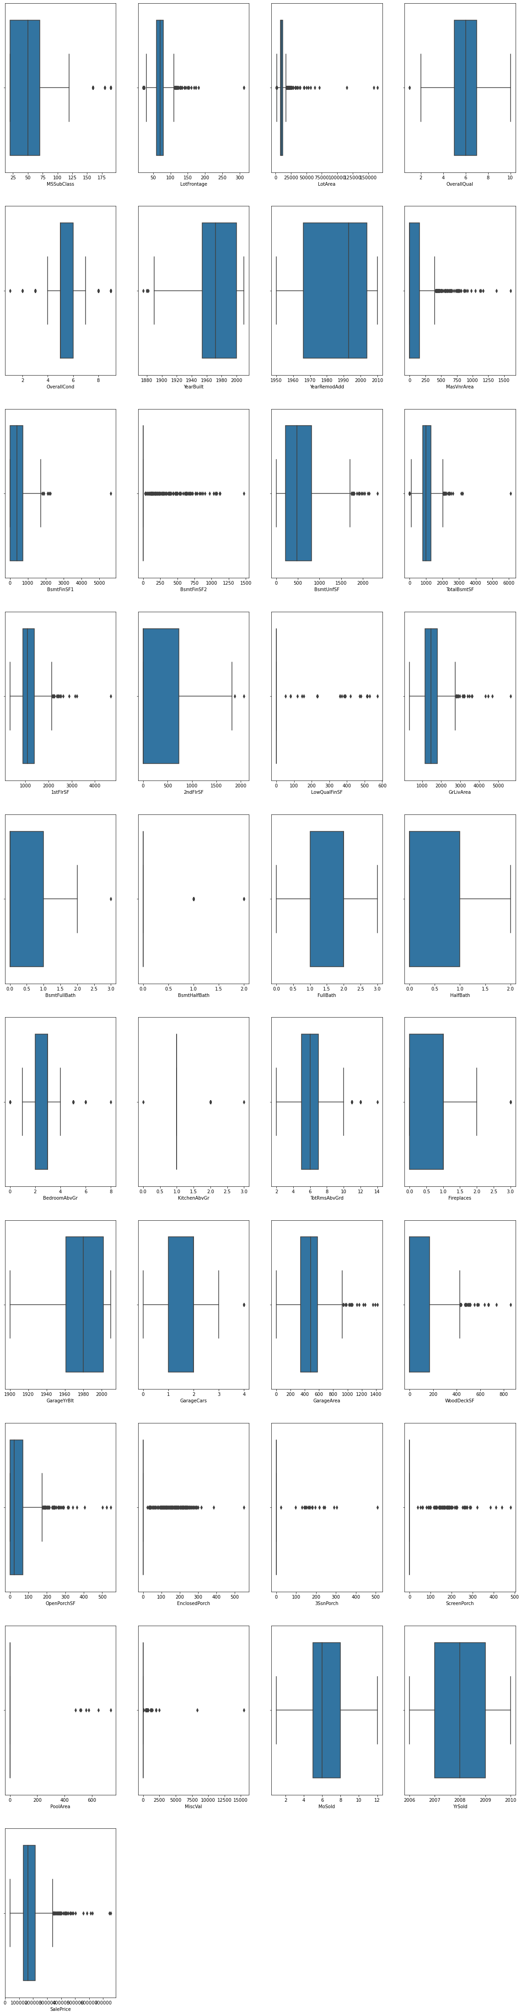
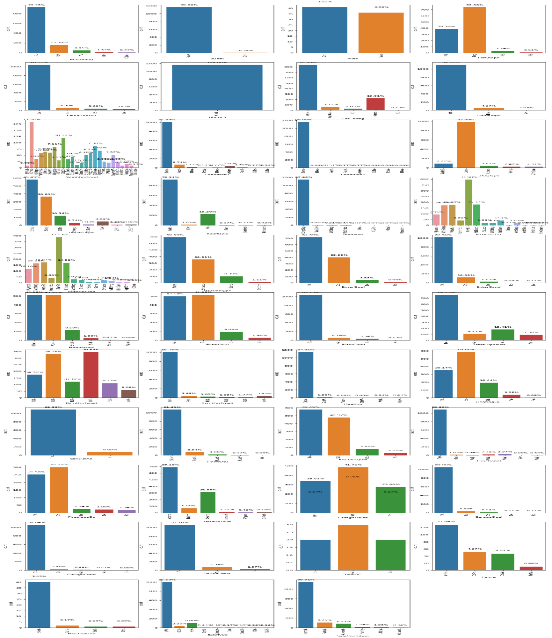
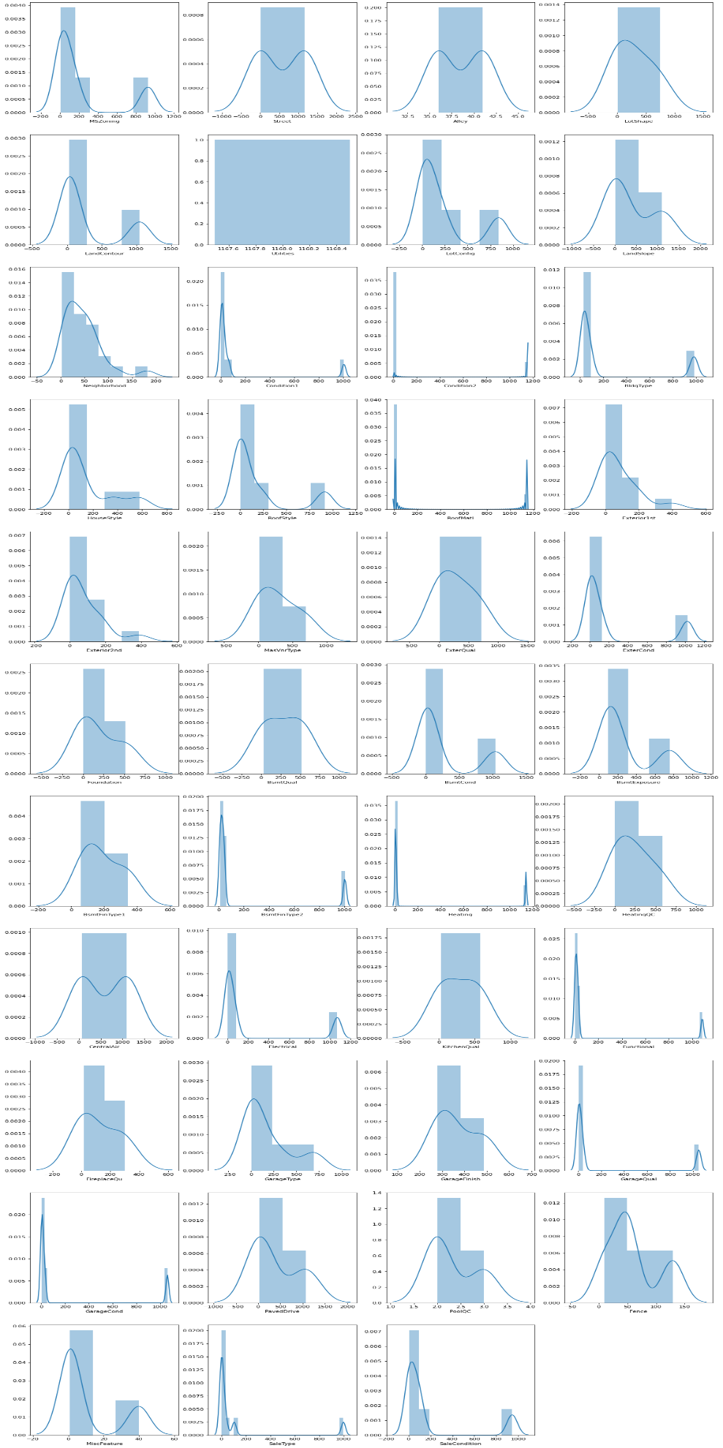
Visualisation – Univariant Analysis

Slide 7
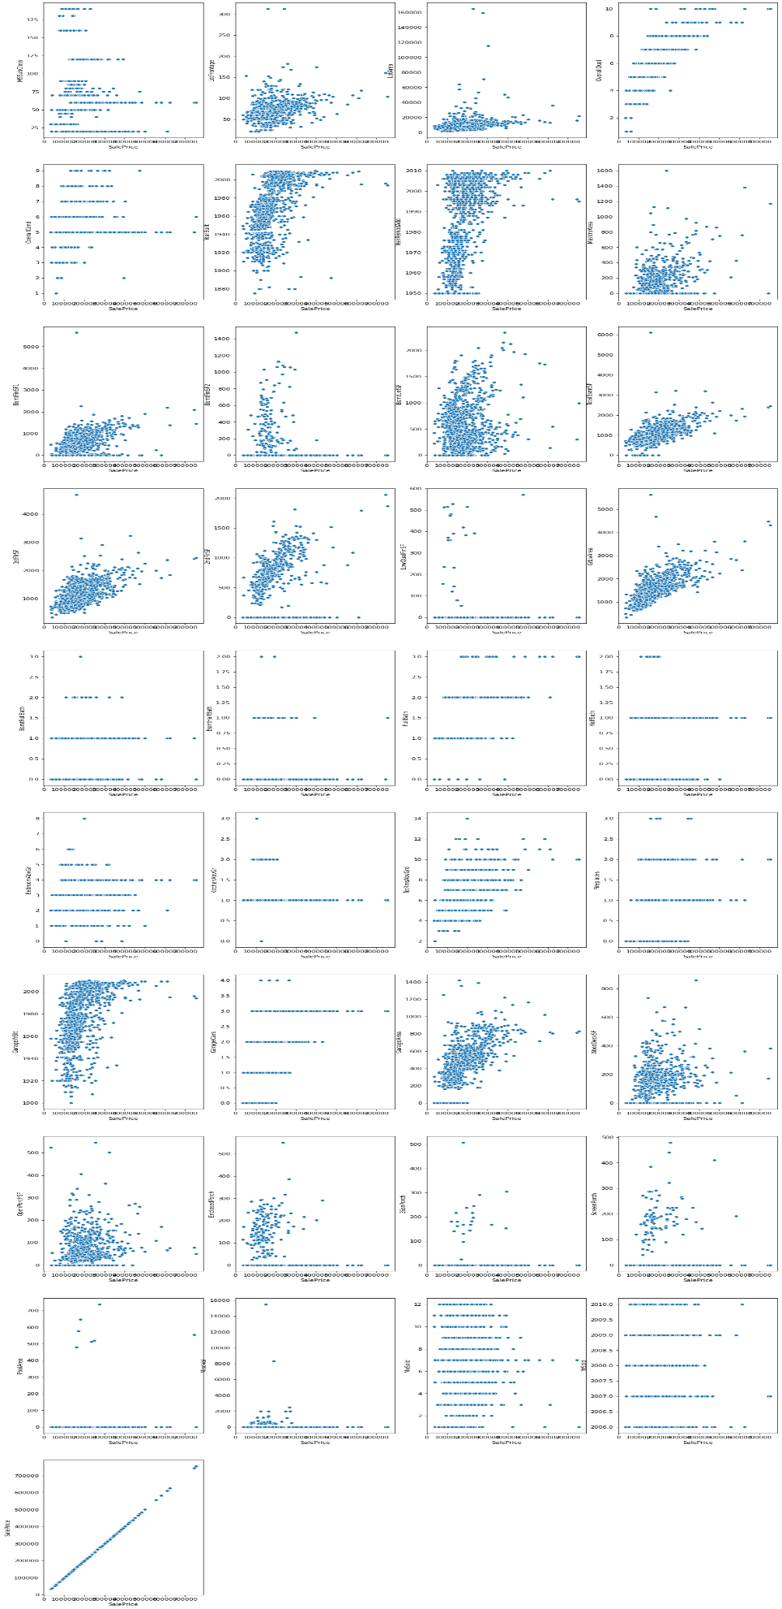
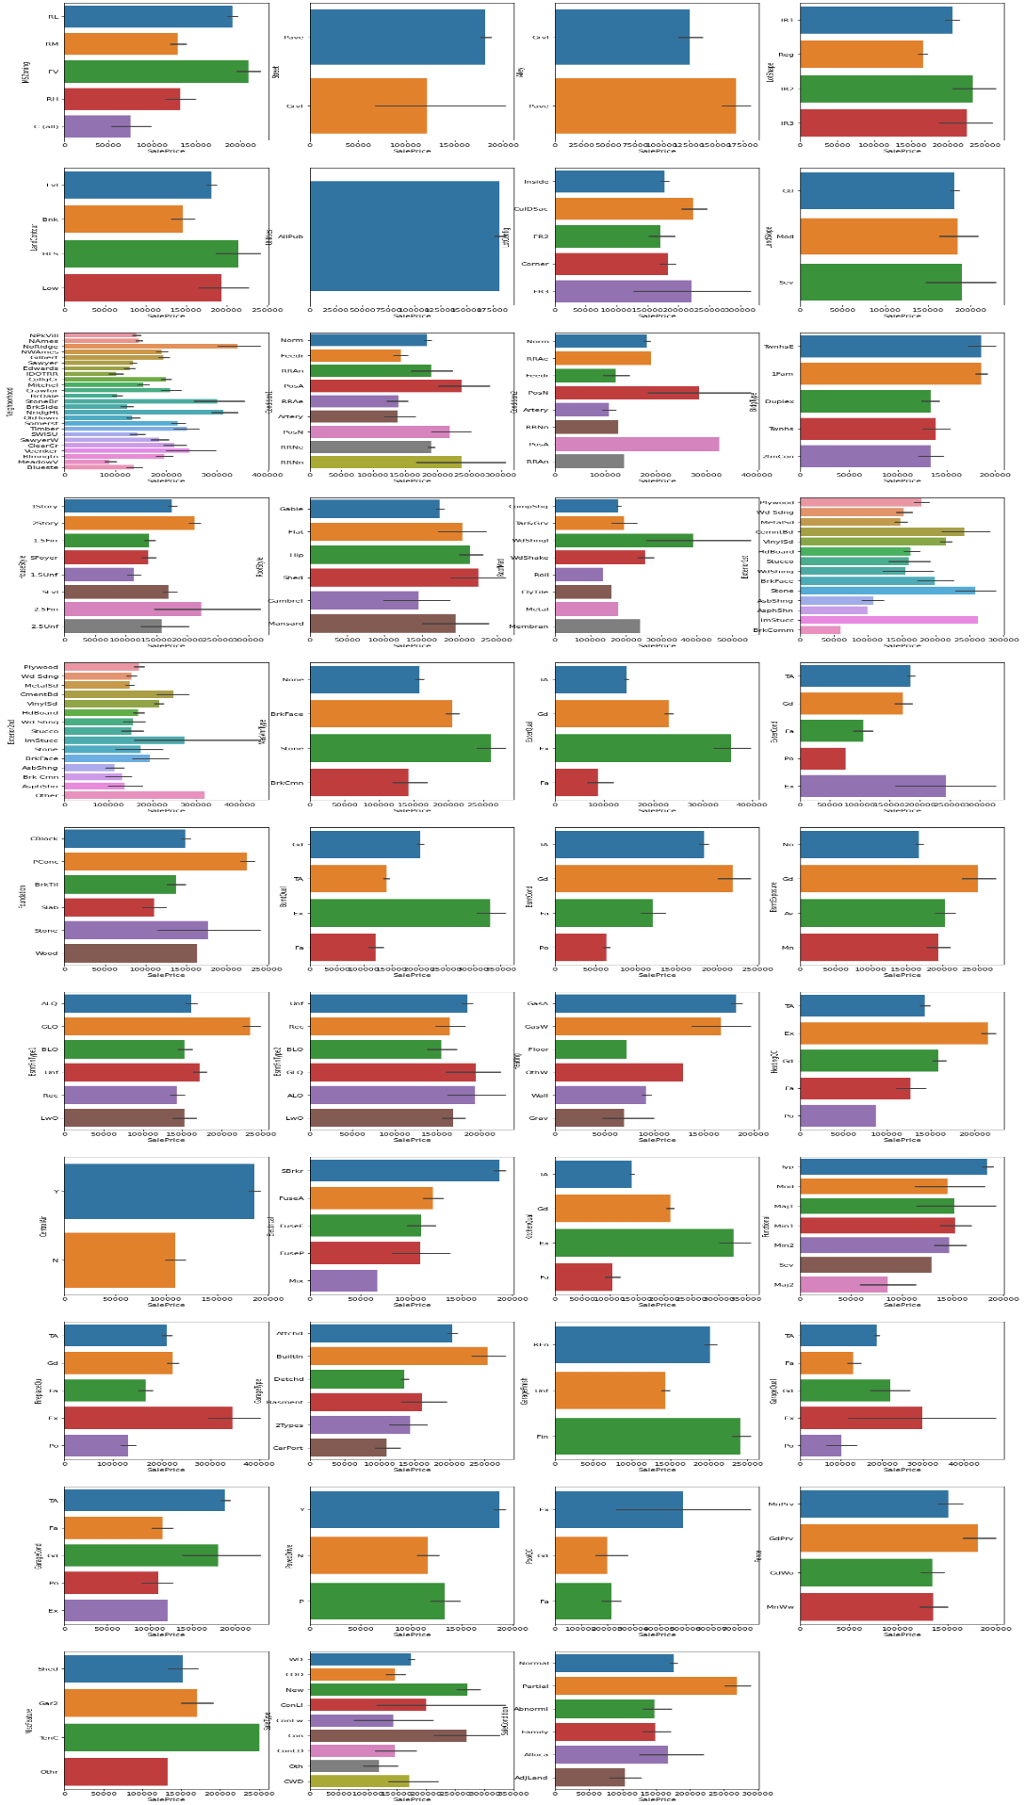
Bi Variant Analysis - Target Variable is Sales Price

Slide 8
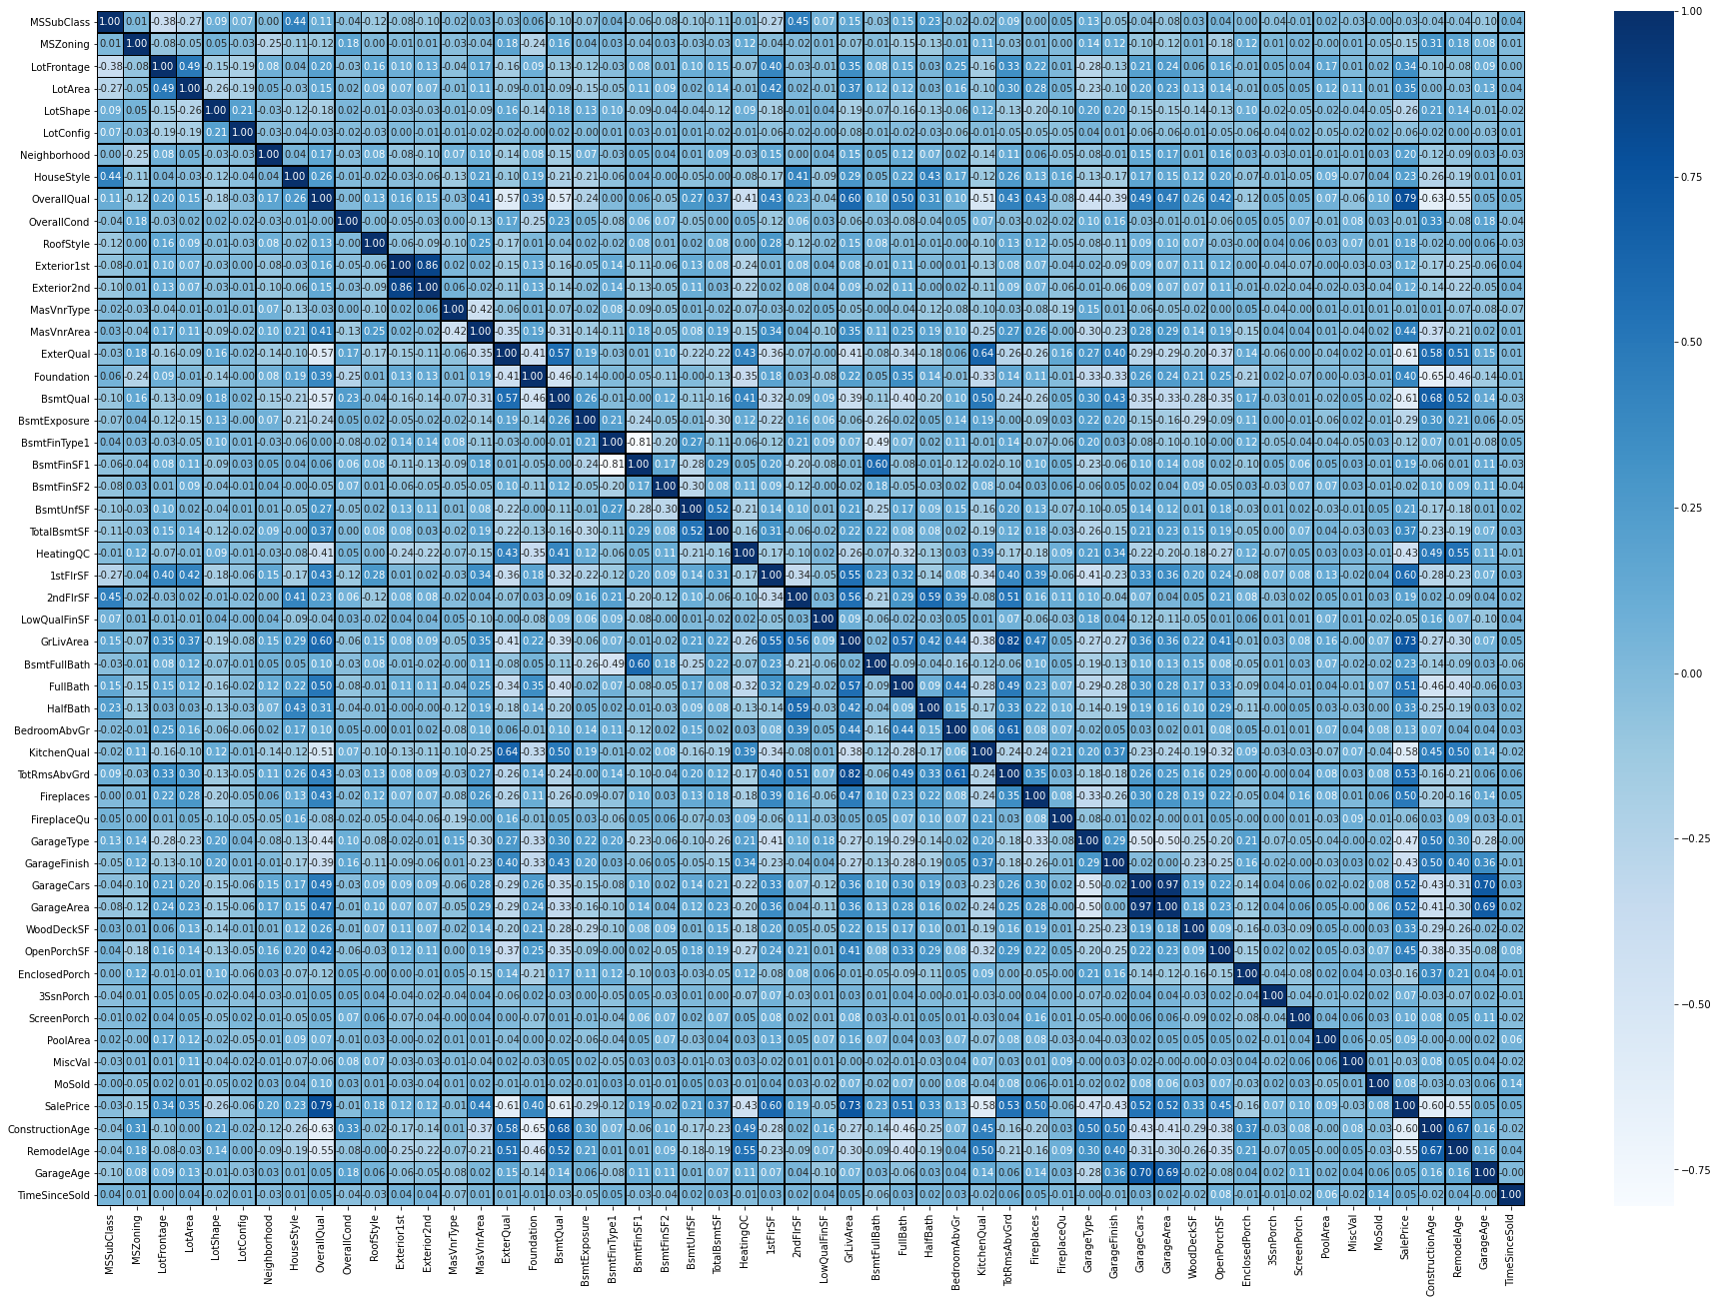
Multi Variant Ananlysis

Slide 9
Steps and Assumptions
Here we see correlation of all features based on saleprice or target.
GarageCars and GarageArea both are high correlation with each others (0.88)
TotRmsAbvGrd and GrLivArea both are high correlation with each others(0.83)
TotalBsmtSF and 1stFlrSF both are high correlation with each others(0.82)
Gradient Regressor is having the Accuracy of 86% which is quite a good score in predicting the model when compare with other model.
The suburb of South Melbourne has the least negative coefficient and a house bought there would cost more.
The suburb of North Melbourne has the most negative coefficient and a house bought there would cost less.
The predictive model i.e. Gradient Regressor accounts for 86% of the variation in prices, which indicates a good accuracy in the predictions.
The model's accuracy and reliability can be improved by excluding the outliers from the model data in future work.

Slide 10
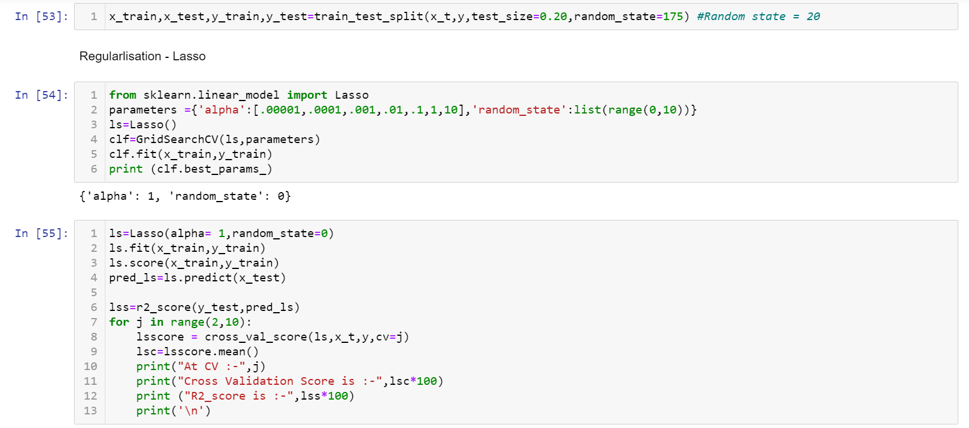
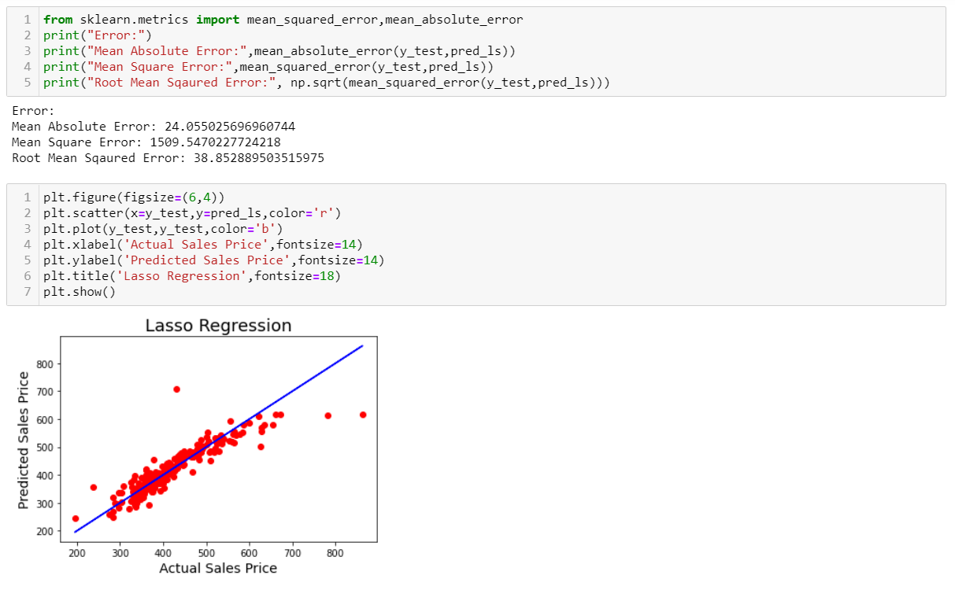
Model – Lasso Regression

Slide 11
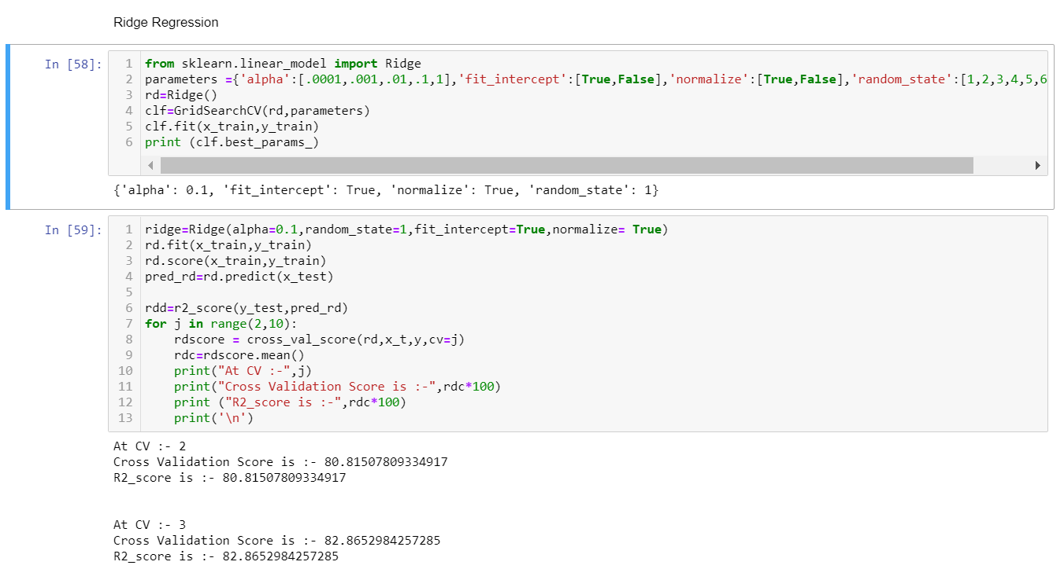
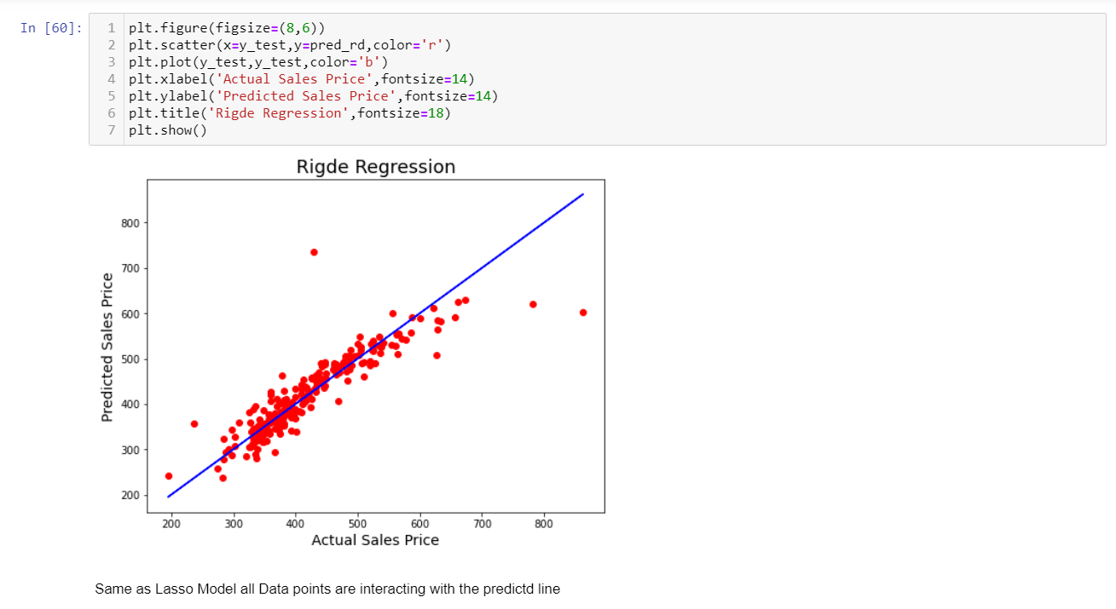
Ridge Regression

Slide 12
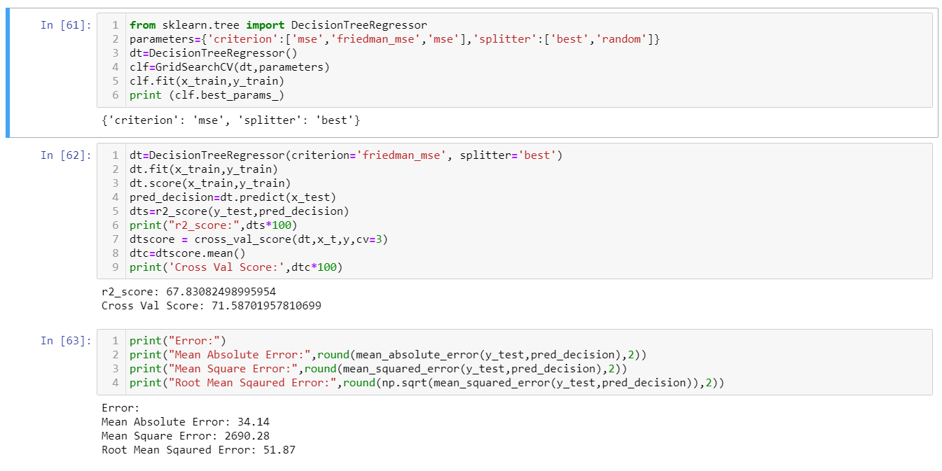
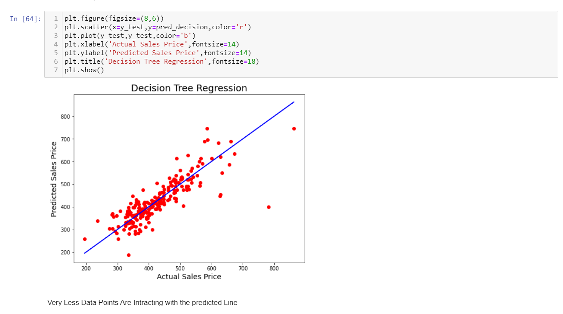
Decision Tree

Slide 13
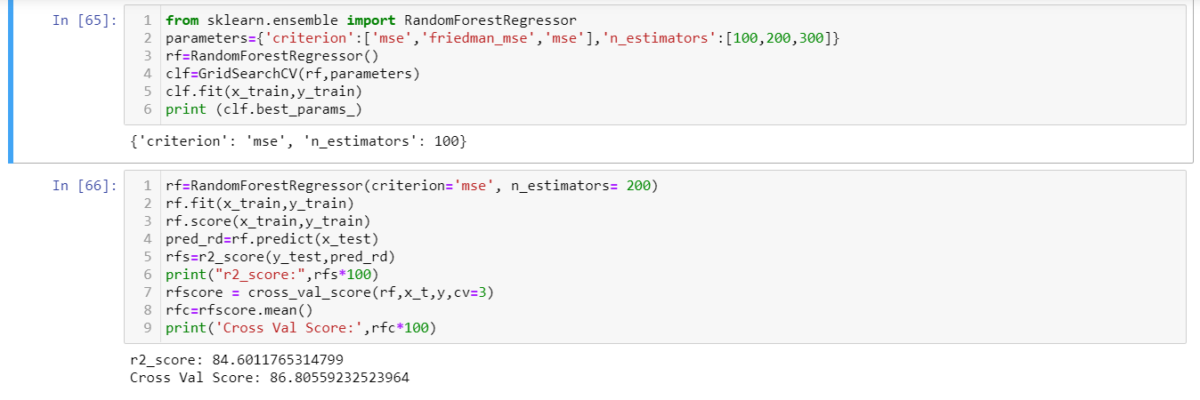
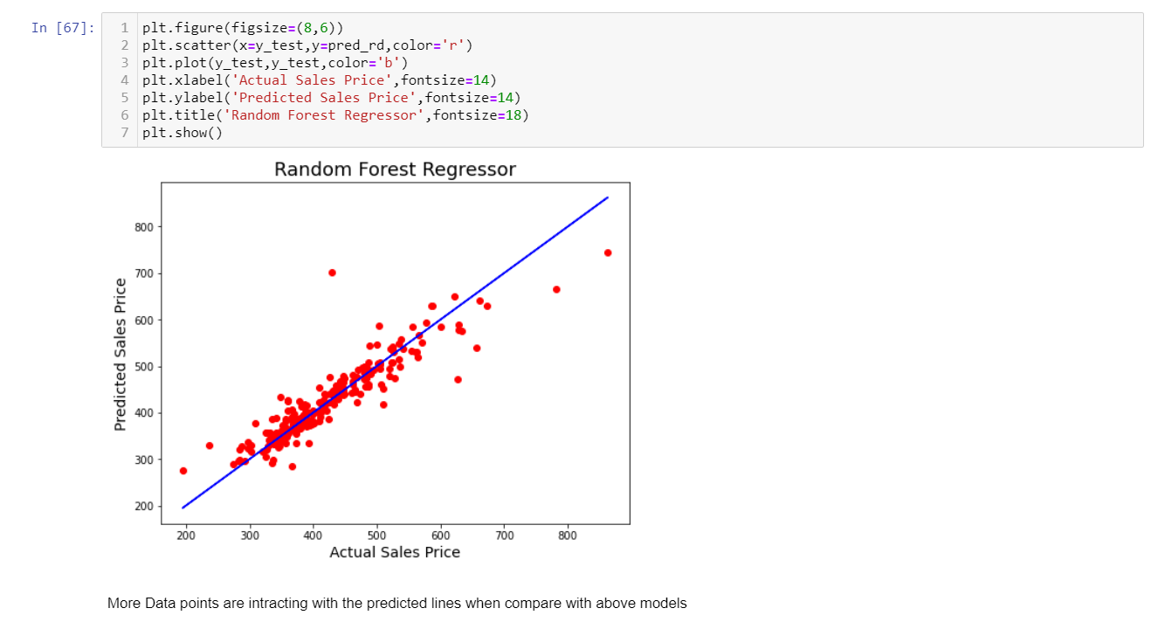
Random Forest

Slide 14
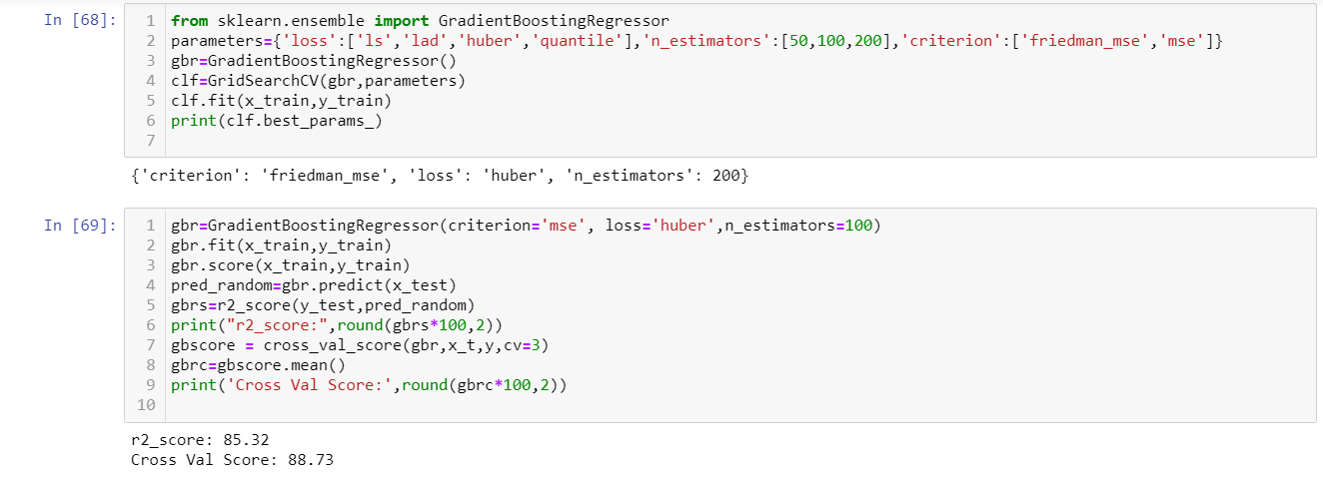
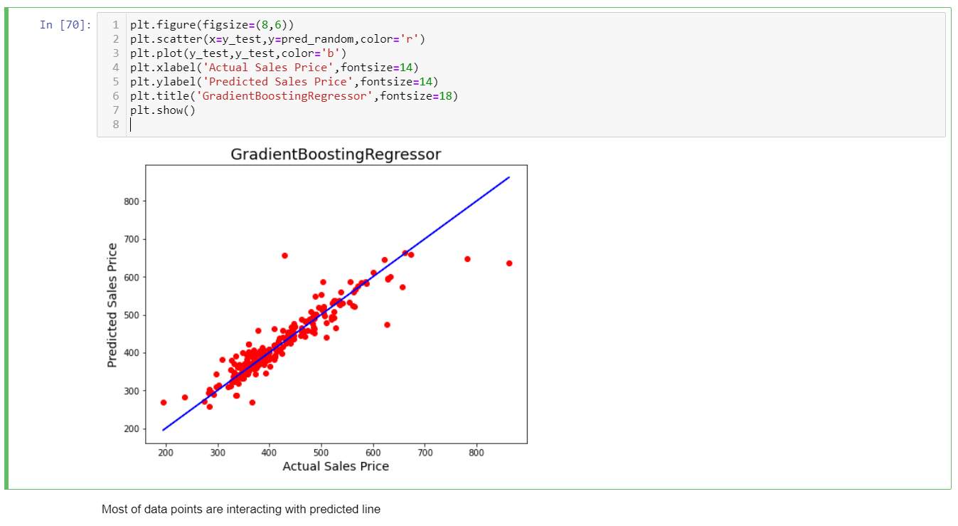
Gradient Regressor – Finalised Model

Slide 15
Conclusion
The study shows a comparison between the regression algorithms and artificial neural network when predicting house prices.
The local data gave a worse outcome when the same pre-processing strategy was implemented due to it being in a different shape compared with the public data in terms of the number of features and the correlation strength.
Hence, the local data needs more features to be added preferably with a strong correlation with the house price.
However, Gradient Regression got the best R2 score overall. The final results of this study showed that Gradient Regression better prediction compared to other used algorithms.

Slide 16

Thank You

